Slide 1
NSAP Eligibility Prediction using Machine Learning with IBM Watsonx.ai Studio
CAPSTONE PROJECT
Presented By:
Karthick Raja K - Christian College of Engineering
and Technology - CSE

Slide 2
OUTLINE
Problem Statement (Should not include solution)
Proposed System/Solution
System Development Approach (Technology Used)
Algorithm & Deployment
Result (Output Image)
Conclusion
Future Scope
References

Slide 3
Problem Statement
The National Social Assistance Program (NSAP) is a welfare initiative by the Government of India to support elderly persons, widows, and individuals with disabilities living below the poverty line. Manually verifying applications and determining the correct pension scheme is time-consuming and often leads to delays or incorrect allocations.
These issues can prevent deserving citizens from receiving timely financial assistance, reducing the overall effectiveness of the program. As the number of applicants increases, it becomes difficult to manage the scheme eligibility process efficiently using manual methods.

Slide 4
Proposed Solution
The proposed system aims to address the challenge of accurately determining the most suitable NSAP scheme for applicants based on their demographic and socio-economic characteristics. This involves leveraging machine learning techniques to automate and enhance the eligibility prediction process. The solution consists of the following components:
Data Collection:
Gather historical applicant data from the AI Kosh NSAP dataset, which includes attributes like age, gender, disability status, BPL status, marital status, income, caste category, and location (state/district).
Data Preprocessing:
Clean the dataset by handling missing values, removing duplicates, and managing inconsistencies.
Normalize or scale numerical features (such as age and income) to improve model performance.
Perform feature selection to retain only the most relevant variables affecting scheme eligibility.
Machine Learning Algorithm:
Implement a Random Forest Classifier, a robust ensemble model that builds multiple decision trees and aggregates their predictions.
Train the model on a labeled portion of the dataset (train-test split) to recognize patterns associated with each NSAP scheme.

Slide 5
Proposed Solution
Deployment:
Use IBM Watsonx.ai Studio on IBM Cloud Lite to train and deploy the model.
Store the dataset in IBM Cloud Object Storage and use AutoAI or Jupyter Notebooks for modeling.
Deploy the final trained model as a Web Service Endpoint, allowing real-time predictions based on new applicant data.
Evaluation:
Evaluate model performance using multi-class metrics Accuracy.
Test the model using multiple input scenarios to validate prediction consistency.
Continuously monitor and improve model performance based on user feedback and new data.
Result :
The Random Forest Classifier achieved an overall accuracy of 98.4%, effectively predicting the correct NSAP scheme based on applicant demographic and socio-economic data.
Multiple real-time predictions were successfully performed using the deployed model in IBM Watsonx.ai Studio, and the outputs were verified using sample inputs and corresponding result images.

Slide 6
System Approach
The "System Approach" section outlines the overall strategy and methodology followed in developing and deploying the NSAP scheme eligibility prediction system. This structured approach ensured the project was accurate, efficient, and deployable using IBM Watsonx.ai services.
System Requirements:
Platform: IBM Cloud (Lite Plan)
Tool Used: Watsonx.ai Studio
Data Format: CSV file from AI Kosh NSAP dataset containing overall applicant details from various states.
Internet: Required for cloud access and deployment
User Access: IBM Cloud account and Watson Studio access
Tools and Platform Used:
IBM Watsonx.ai Studio: Used to develop the ML model through visual pipeline (no-code environment).
Random Forest Classifier: Selected automatically by Watsonx AutoAI as the best-performing model.
AutoAI Service: Handled automated preprocessing, model selection, training, and optimization.

Slide 7
Algorithm & Deployment
Algorithm:
The Random Forest Classifier algorithm was used to train the model.
It is a supervised machine learning algorithm that works by constructing multiple decision trees and combining their results for improved accuracy.
The algorithm was automatically selected by IBM Watsonx.ai Studio’s AutoAI as the best performer after testing multiple models.
Deployment Approach:
The model was developed using the AutoAI tool inside IBM Watsonx.ai Studio, which required no coding.
The dataset (CSV format) was uploaded to IBM Cloud Object Storage and connected directly to the AutoAI pipeline.
Once training was complete, the best model (Random Forest) was deployed as a Web Service Endpoint using IBM Watsonx.ai.
Predictions were generated in real-time by uploading new input data (CSV files and test cases).

Slide 8
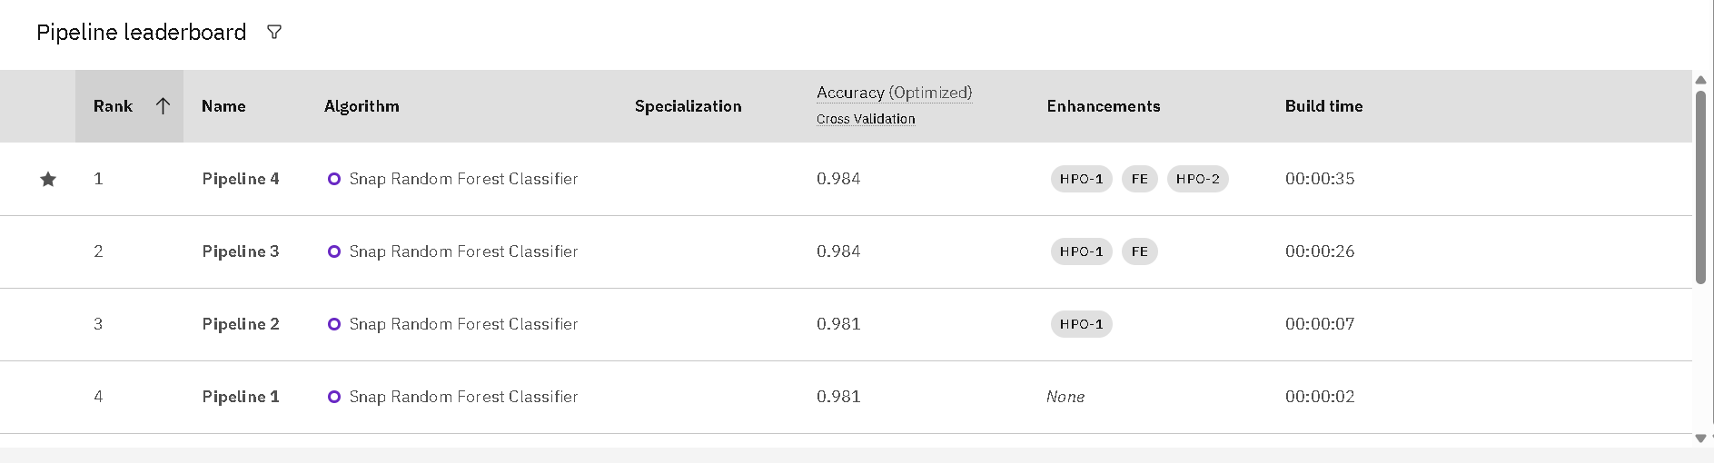
Result
The model trained using the Random Forest algorithm accurately predicted the correct NSAP scheme for each applicant.
It was deployed successfully using IBM Watsonx.ai Studio, and prediction results were tested with real applicant data.
Sample inputs were given, and the model returned correct scheme predictions with high accuracy.

Slide 9
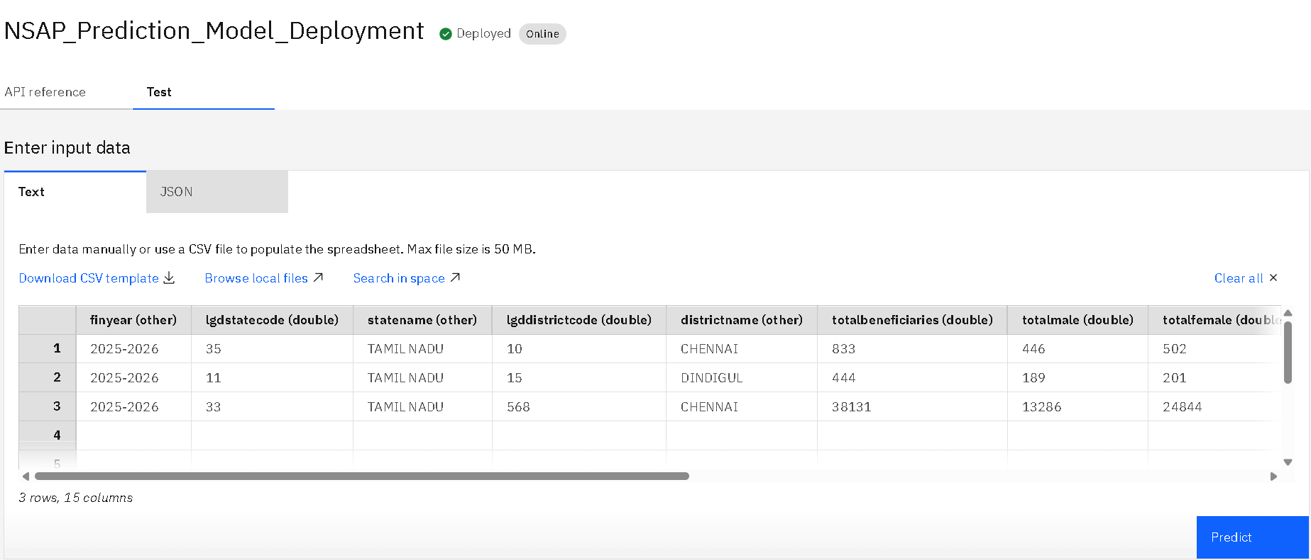
Result

Slide 10
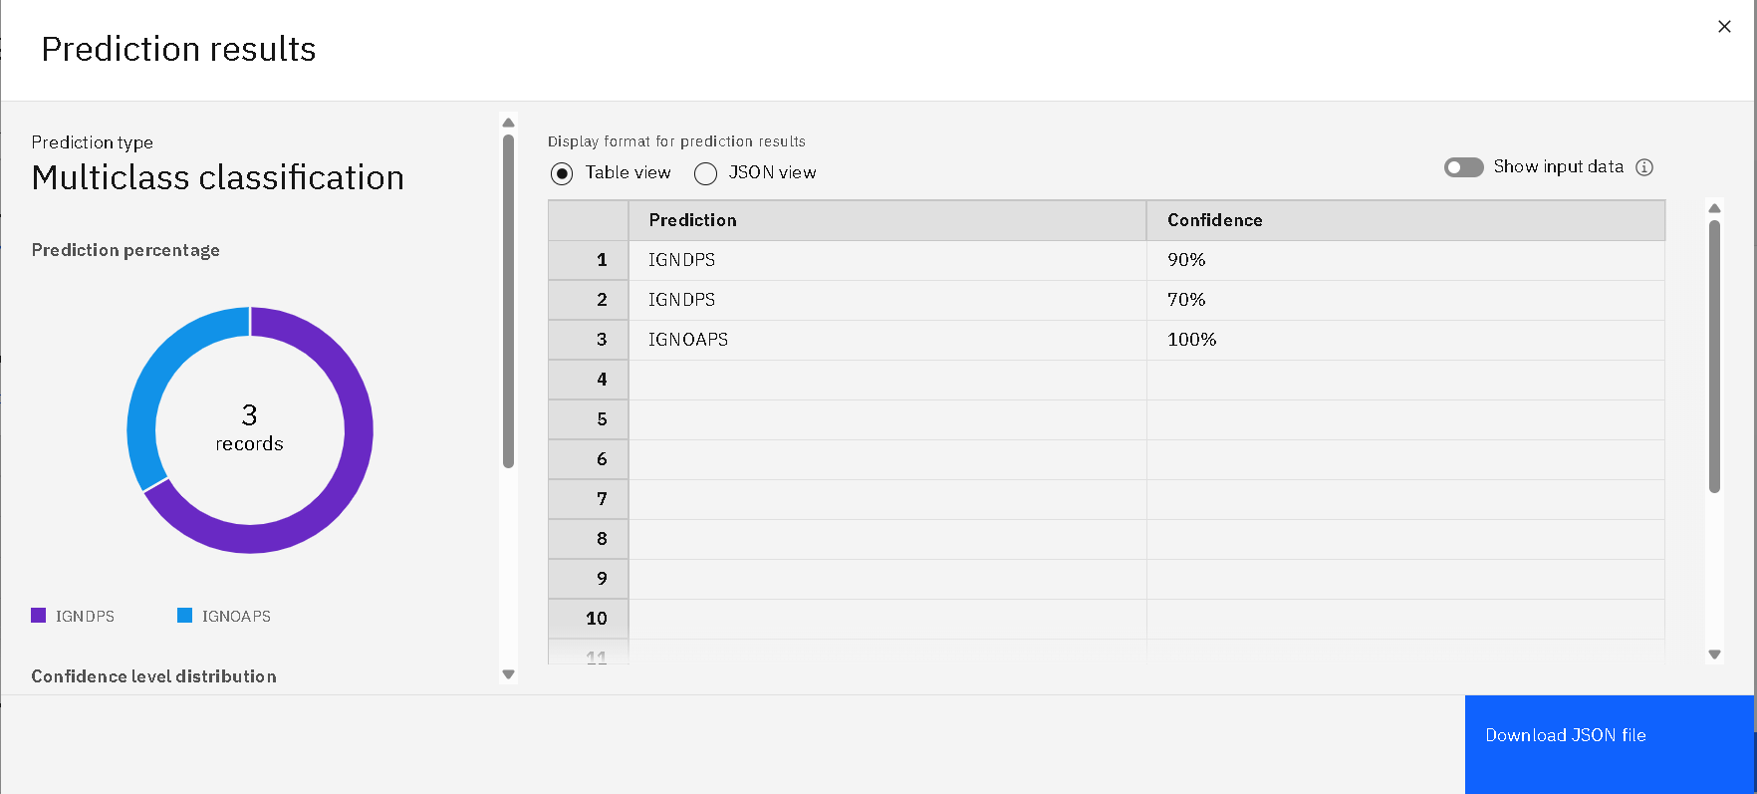
Result

Slide 11
Conclusion
The NSAP Eligibility Prediction system was successfully developed using a no-code approach on IBM Watsonx.ai Studio. The primary goal was to automate the classification of applicants under the correct NSAP scheme using their demographic and socio-economic information. The use of the Random Forest Classifier helped in building a robust and accurate model, selected automatically by IBM AutoAI based on performance metrics. The dataset used contained real-world records from the AI Kosh NSAP pension data, covering multiple states and applicant categories.
Through proper preprocessing and visual model training, the system was able to generate reliable predictions and significantly reduce the manual workload involved in scheme allocation. The project demonstrated the power of cloud-based AI tools like Watsonx.ai in making machine learning accessible without the need for traditional coding. The final model was deployed as a web service, allowing government officers to input new applicant data and instantly receive scheme recommendations. Overall, the project improved efficiency, ensured better delivery of welfare, and proved the real-world impact of AI in public service domains.

Slide 12
Future scope
Enhanced Feature Set
Future versions of the system can include additional features such as education level, occupation type, and household size. These variables can help the model better understand the applicant's socio-economic status and improve prediction accuracy.
Mobile and Web Application Development
A user-friendly mobile app or web-based platform can be developed to allow government officials and applicants to access the prediction system easily. This would enable field-level officers to use the tool in real-time during field visits or data collection drives.
Integration with Government Databases
The model can be connected with official databases like Aadhaar, income certificates, or BPL registers to automate and verify applicant details in real time. This will reduce manual verification and improve system reliability.
Multi-language Support
Adding regional language support to the interface will make the system accessible to applicants and staff in different parts of India, especially in rural and underserved areas. It will promote inclusivity and broader adoption.

Slide 13
References
AI Kosh NSAP Dataset National Social Assistance Programme (NSAP) – District-wise Pension Data https://aikosh.indiaai.gov.in
IBM Watsonx.ai Documentation IBM Cloud Docs – Watsonx.ai Studio https://www.ibm.com/docs/en/watsonx
Breiman, L. (2001). Random Forests. Machine Learning Journal, 45(1), 5–32. https://link.springer.com/article/10.1023/A:1010933404324
IBM AutoAI Overview https://www.ibm.com/cloud/watson-studio/autoai

Slide 14
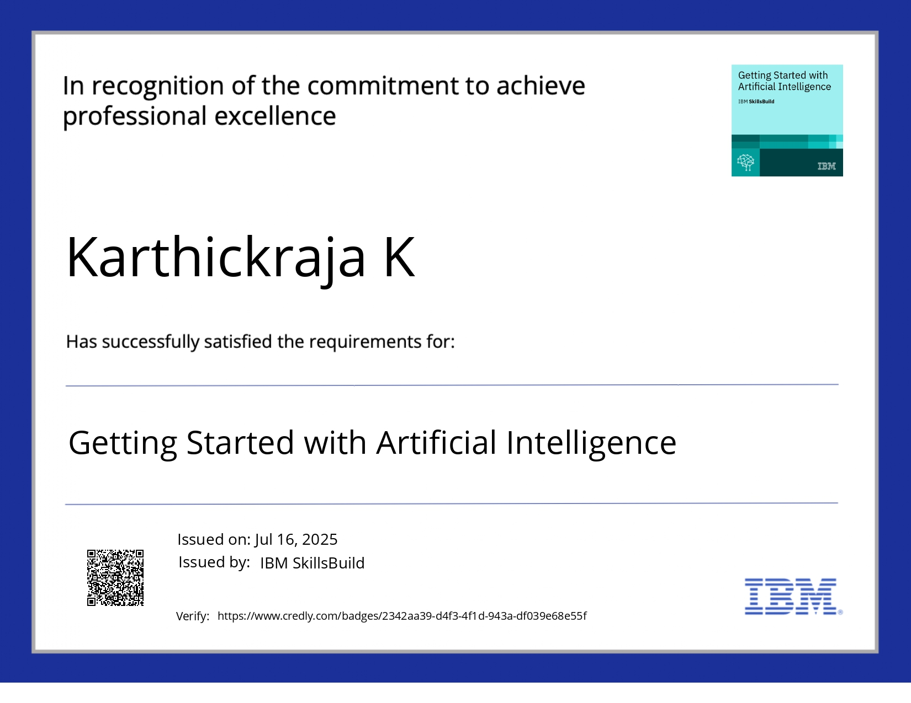
IBM Certifications

Slide 15
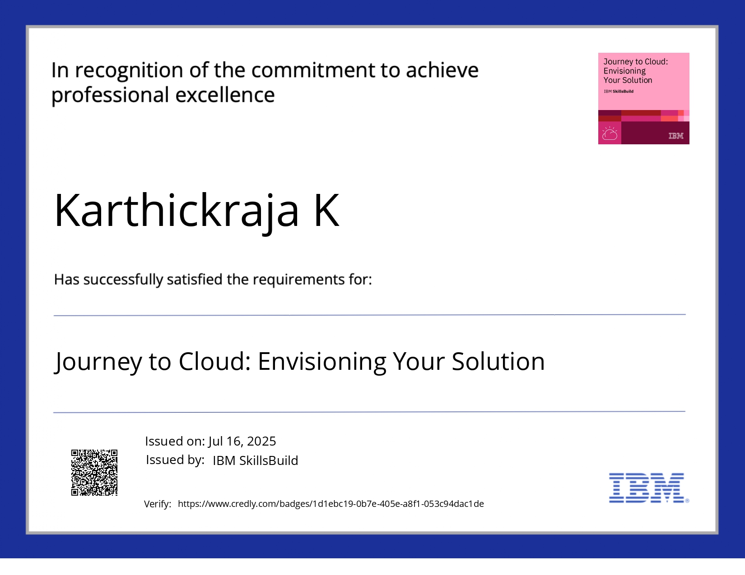
IBM Certifications

Slide 16
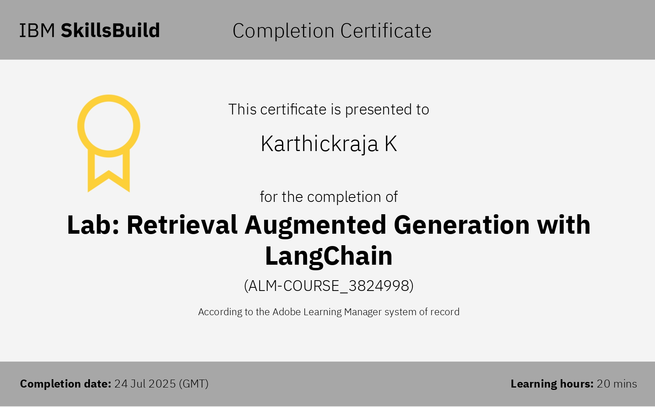
IBM Certifications

Slide 17
THANK YOU

